Slide 1
Media Server G

Slide 2
XOR Media Architecture
Production/MAM
Data source for graphic templates
Play to Air (SD/HD/4K)
AVID
FCP
DALET
ADOBE
PREMIERE
Database
file
internet
FTP
SMB2
SMB2
Live
data
Net Disk
Journalist
Videos / Images
HTTP
SDI
Cloud Aqua
Channel in Box
LAN/WAN
Channel in Box
SMB2
Video clips/
Templates
Ingest
IPTV
Automation
API/VDCP
Playlist Preload
API/VDCP
XOR Media
Controller
Tool
Cloud Aqua
Media Server C
Traffic System
3rd Party
Automation
3rd Party
Traffic System
Media Server G
IP Stream
CDN
Baseband
Live
feed
Studio
Outside
Broadcast
Live
3rd party Cloud

Slide 3
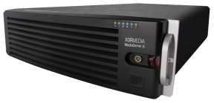
MediaServer G Series
Channel in a box perfect for branding and playout
Notes:
3

Slide 4
MSV-G Models
MODEL | INPUT/OUTPUT (input is only for live bypass, no encoders) | STORAGE
MSV-G422 | 2-input-2-output | No embedded storage 8 x 1TB/2TB/4TB/8TB HDD 8 x 240GB/480GB/960GB/1.92TB/3.84TB SSD 16 x 1TB/2TB/4TB/8TB HDD 16 x 240GB/480GB/960GB/1.92TB/3.84TB SSD
MSV-G844 | 4-input-4-output
MSV-G4K11 | 1-input-1-output

Slide 5
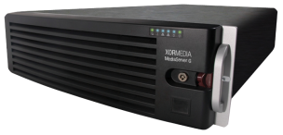
Broadcast-quality Channel-in-box Server
3RU server chassis
flash SSD boot service disk
Redundant, hot-swappable power supplies
RAID6 protection of different HDD/SSD storage options
No internal storage – use UML N as storage
With eight or sixteen 1TB/2TB/4TB/8TB HDD or 240GB/480GB/960GB/1.92TB/3.84TB SSD
High performance GPU graphic rendering
4GB GDDR5 GPU memory
128-bit memory interface, 80GB/s bandwidth
CUDA Cores: 640

Slide 6
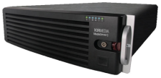
File Format Supported
All formats support
Back-to-back playout
Up/down and cross conversion
Closed captioning & subtitles
ARC, AFD, CC and Teletext
Video formats
AVCIntra / DNxHD Native
QuickTime MOV
AMWA AS02
MXF OP Atom / MXF OP 1A
XDCAM HD / XDCAM HD422
MPEG-2 PS or TS
IEC-DV(DVCAM or DVSD)
XAVC
Audio formats
PCM
MPEG lay II
AES
Dolby E
Dolyby D /AC-3

Slide 7
Open Technology
Standardized interface and control protocol
Provide API to control playout, signal routing
Provide branding protocol for external automation integration to control branding
Support VDCP, Sony for playout control
Integrated SNMP 2.0
Seamless integration
Crucial role in XOR Media Architecture
Communicate with third-party applications such as automation system and media asset manager, including the XOR MediaController Tool
Support stream-through from XOR UML N Cloud Aqua storage

Slide 8
Advanced Capabilities
Provide FTP server capability
Provide file ingest/file transfer capability
Support signal routing, no binding limitation between input and output
from any live input to any output port (4x4);
from one live input to any or all output ports
Support IP stream be sent to XOR Cloud Aqua, CDN, 3rd party Cloud or local IPTV media server. Each branding channel could have following live low bitrate IP streaming
HLS for 6 formats simultaneous output
H.264 format for both SD and HD output
Support delayed live signals for output
IP encapsulation supporting SMPT 2022-5/6
Support loudness control

Slide 9
Rich Branding Capabilities
Up to 4 play-to-air level real-time branding channels (4 on-air output, or 2 on-air+2 preview branding output)
Use OpenGL 3D technique to render enriched templates in real time
Up to 8 layers for logos (static/animated), text crawls, commercial messages, and TV events preview
Support updating template elements on the fly
Graphics can be driven directly from the playlist or manually triggered
Support dynamic data source from database, file base (XML, txt, etc.) and internet for rendering

Slide 10
Maximum 4 Layers DVE
Automated or manual control of DVEs
10-bit processing and sub-pixel motion and scaling

Slide 11
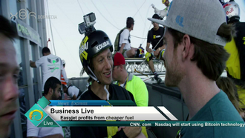
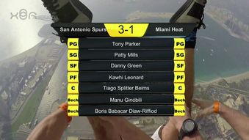
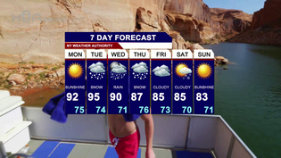
Real Time Rendering Enriched Templates
News
Sports
Weather
Next presentation

Slide 12
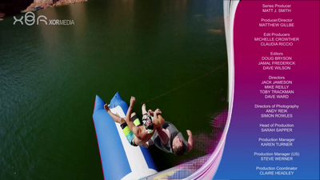
Resize & Rolling Credits
Horizontal
Vertical

Slide 13
Up to 8 Layers Branding
Ticker
DVE
Stock
Crawl
Weather
Logo
Clock

Slide 14
Dynamic Data Connectivity
Dynamic data can be sourced from internet, database or file for rendering

Slide 15
XOR MSV-G Workflow
Production/MAM
Data Source for Graphic Templates
ADOBE
Flash Professional
Database
File
Internet
Automatic data feeds for weather, news, etc
Play to Air (SD/HD/4K)
Channel in Box
SDI/IP out
Media Server G
SWF graphic files
Compose graphics and videos in real-time in SDI or IP Streams
IP Stream
IP Stream
UML N
Live SDI directly to MSV-G
Video clips from storage, e.g. UML, CloudAqua, or MSV-G local storage
Play out control via VDCP or MCC API
Branding control via Oxtel/CII/branding control API
CDN
Baseband
Storage
Automation
XOR Media
Controller
Studio
Outside
Broadcast
Live
UML N
3rd Party
Automation
3rd Party Cloud
UML

Slide 16
XOR MediaController Tool – MSV-G Control
Configuration: Configure different Channel info
Scheduling Channel: Create scheduling list
Playback Channel: Control the playlist for playout and branding automatically
Manual Channel: Control the signal routing, template/scene manually
Preview Channel: Support Clip+Scene/Live+Scene Preview

Slide 17
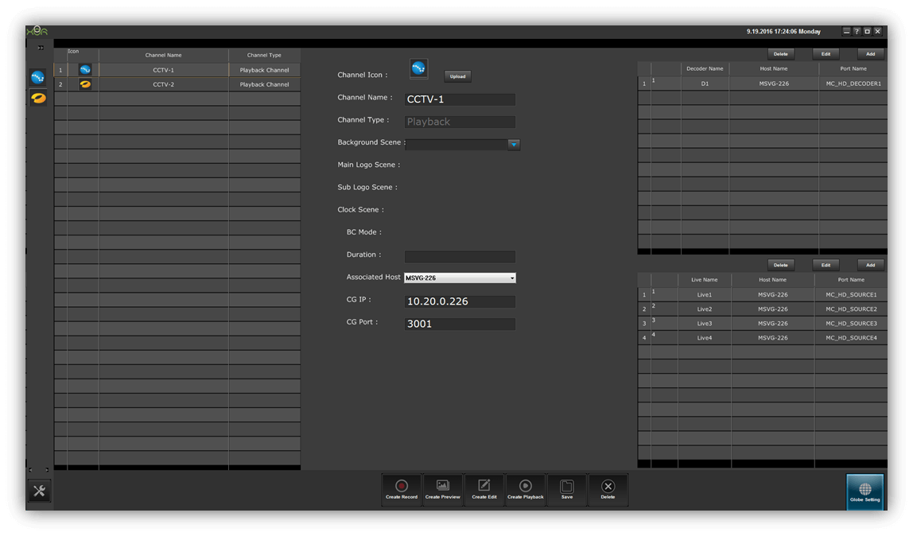
MCT – Configuration

Slide 18
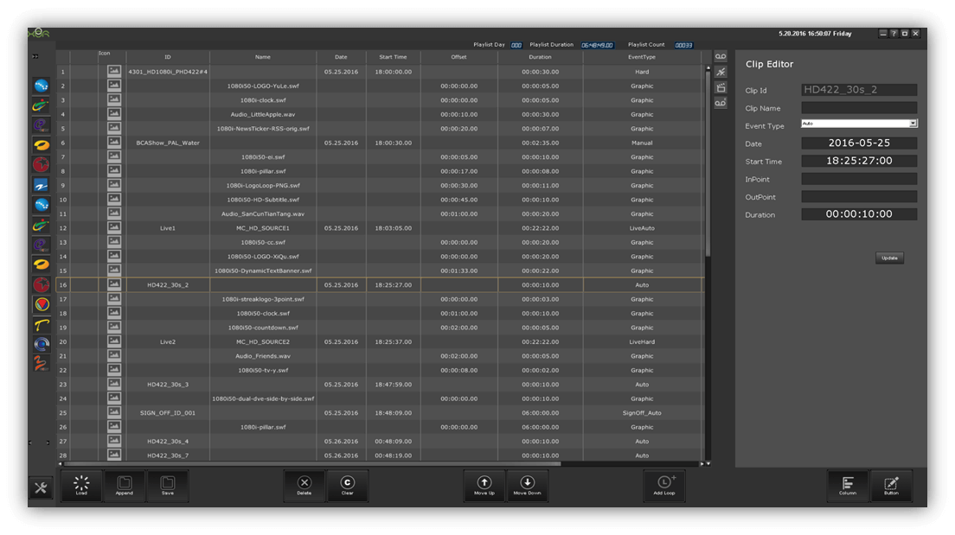
MCT – Scheduling
Create Scheduling List

Slide 19
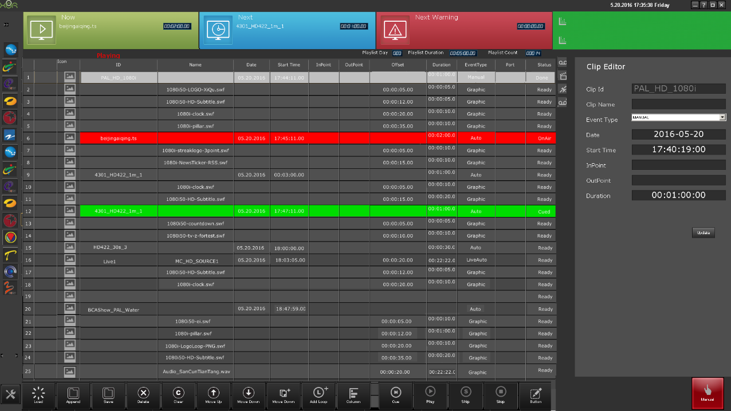
MCT – Playlist-1
Create the playlist for both program and templates/scenes
Validate the playlist
Control the playlist for playout and branding automatically
Control the signal routing, template/scene manually
Edit template elements on the fly

Slide 20
MCT – Playlist-2
Branding effect on output Monitor

Slide 21
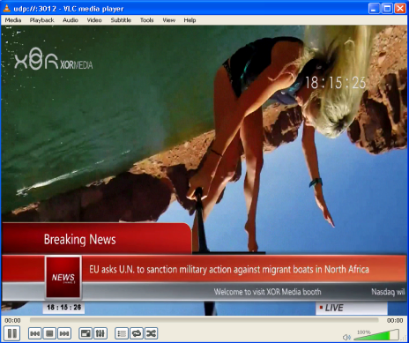
MCT – Playlist-3
If IP Streaming function is enabled, you can also review the low bitrate stream simultaneously.

Slide 22
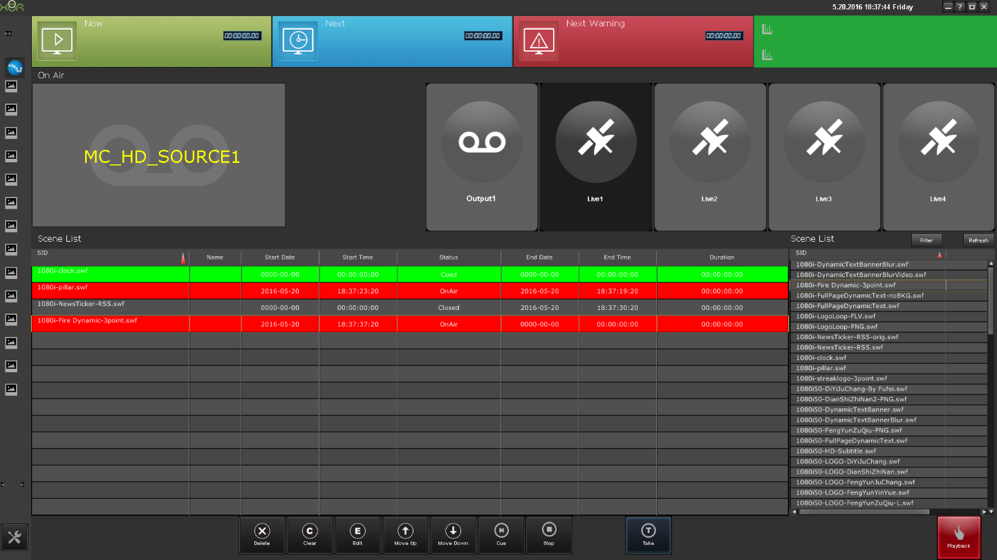
MCT – Manual Control
PGM output monitor
Manual control of signal switch
Manually control graphic rendering

Slide 23
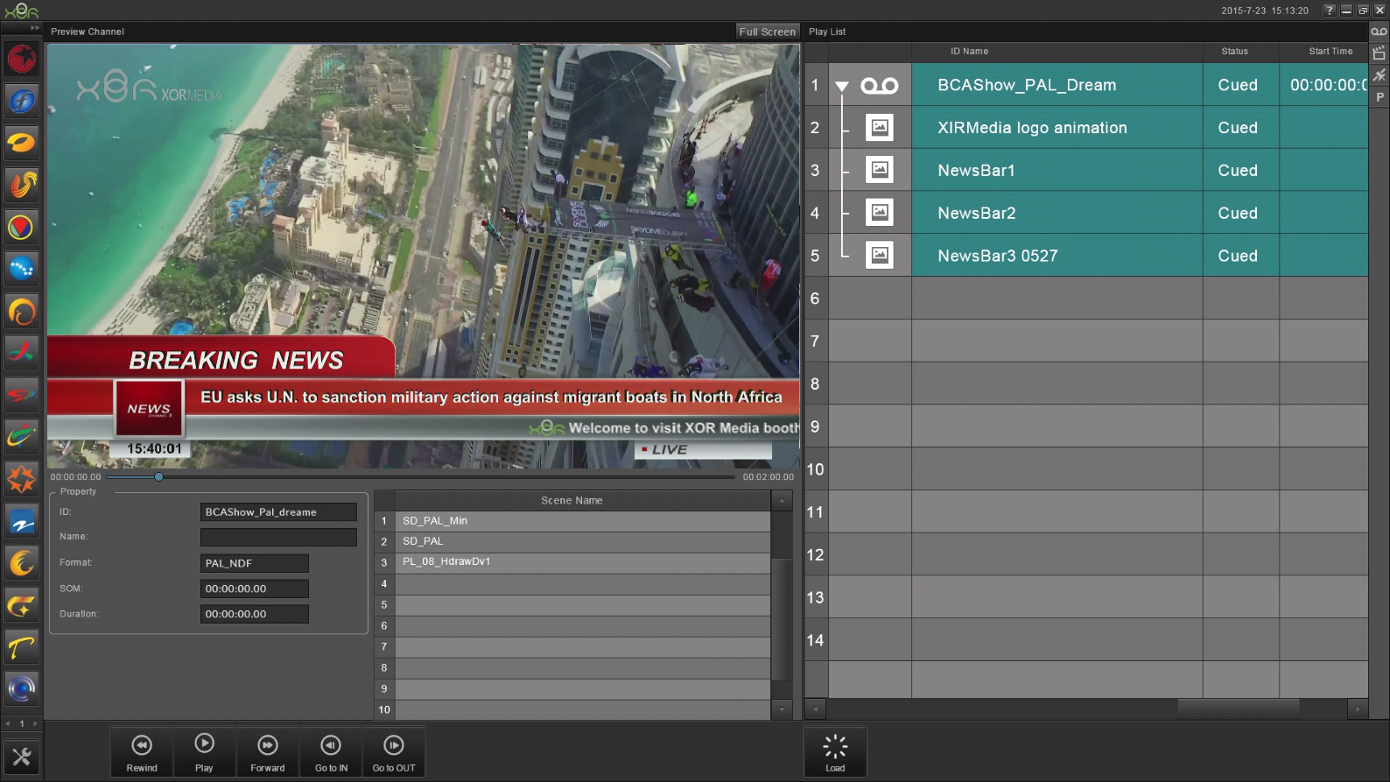
MCT – Preview
Clip
Scene
Clip + Scene
Live
Live + Scene
Playlist

Slide 24
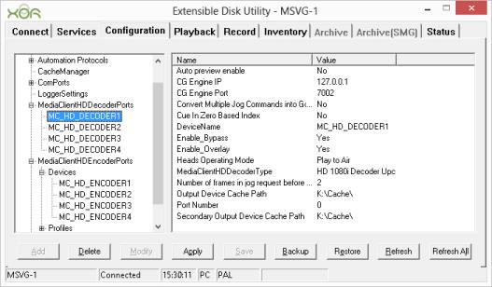
Configuration Utility
Configure the external control mode
Configure the input and output ports
Configure the branding related settings
Enable IP Stream

Slide 25
Highlights
Maximum 4 play-to-air level branding channels in a 3RU box
Rich branding capabilities, live data connectivity, DVE
Provides various interfaces and protocols, including branding control protocol for external automation
Supports video routing from any input to any output port; or from one input to any/all output ports
Switches between live feeds and playlist programs
Integrated Broadcast-quality Server, with Advanced Real-Time Graphics and DVE

Slide 26
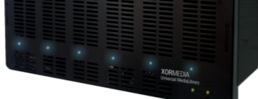
Thank you!
Notes:
26

